Slide 1
Discussion 7: Asymptotics
Please fill out the quiz, when you get it.

Slide 2
Administrivia
Project 2 Phase 1 due February 26
Project 2 Phase 2 due March 5th
Labs this week will be working on project 2
Don’t forget to fill out the partner feedback form!
https://goo.gl/forms/lHu4d2DzldVwtJST2
Notes:
The first question is fairly straightforward, but the goal is to get students thinking about flaws in more conventional ways of measuring how fast a program runs, like timing or counting the number of operations. The discussion will probably lead you to students saying you can come up with an algebraic expression for the number of operations based on the inputs.
The second question hopefully will guide students to about what exactly we need to measure when comparing the runtime of two programs. Different from measuring something with a tangible quantity like time, we need to be able to generalize to all different kinds of input and think about worst case inputs as well. Hopefully this gets students to think of inputs where the size approaches infinity - a good segue into big o notation.

Slide 3
Motivation: Measuring Runtime
How do we measure the runtime of a program?
How do we compare the runtime of two programs as the input size grows?
Notes:
The first question is fairly straightforward, but the goal is to get students thinking about flaws in more conventional ways of measuring how fast a program runs, like timing or counting the number of operations. The discussion will probably lead you to students saying you can come up with an algebraic expression for the number of operations based on the inputs.
The second question hopefully will guide students to about what exactly we need to measure when comparing the runtime of two programs. Different from measuring something with a tangible quantity like time, we need to be able to generalize to all different kinds of input and think about worst case inputs as well. Hopefully this gets students to think of inputs where the size approaches infinity - a good segue into big o notation.

Slide 4
Measuring Order of Growth
Determine a cost model (in this case number of operations)
Define an algebraic expression f(n) that expresses this cost for some input n.
Drop multiplicative constants and lower order terms
Any exponential dominates any polynomial
Any polynomial dominates any logarithm
Notes:
Based on the previous discussion, students should come up with some way to ‘count’ operations of a given process and then come up with an algebraic expression for the operations.

Slide 5
Θ (Big Theta)
Let f(n) and g(n) be positive real numbers on inputs of size n
f ∈ Θ(g) if there is a constant c1 > 0 and c2 > 0 s.t.
c1 g(n) <= f(n) <= c2 g(n) for all c1 <= c2
Tightly bounded by g(n) when n gets significantly large.
Notes:
The important point here is big theta is just squeezing the runtime between big O and big Omega. It’s a tight bound so best and worst case. Always case.

Slide 6
Problem 1a: Ordering Big- Runtimes
If you’re stuck, think about the big-O runtimes as functions and compare the values of the functions as n becomes really large.

Slide 7
Problem 1a: Ordering Big-Θ Runtimes
Θ (1) ⇢ Θ (logn) ⇢ Θ (n) ⇢ Θ (nlogn) ⇢ Θ (n^2 logn) ⇢ Θ (n^3) ⇢ Θ (2^n) ⇢ Θ (n!) ⇢ Θ (n^n)
Notes:
Teaching Goals: Develop a basic understanding of how to compare runtimes.

Slide 8
Common Asymptotic Sets
Θ (1): constant
Θ (log n): logarithmic
Θ (sqrt(n)): square root
Θ (n): linear
Θ (n log n): n log n
Θ (n^2): quadratic
Θ (n^3): cubic
Θ (2^n): exponential
Θ (n!): factorial
Notes:
Good recap after the first problem.

Slide 9
Problem 2a: Analyzing Runtime
What are all the possible things that could happen with the code?
Remember to think generally in terms of large inputs for M and N.
Notes:
Teaching Goals: Take concepts introduced about runtime and apply them to analyzing real code.

Slide 10
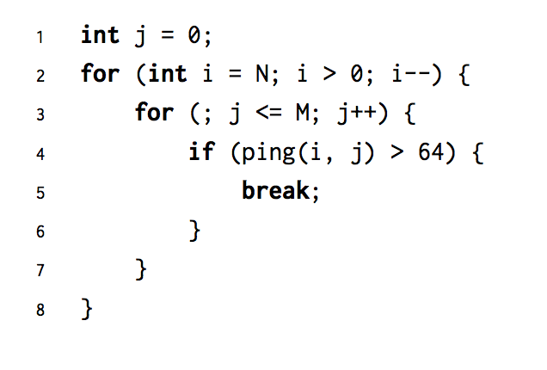
Problem 2a: Analyzing Runtime

Slide 11
Problem 2a: Analyzing Runtime
Worst case: M + N
Best case: N

Slide 12
Problem 2b: Analyzing Runtime
Be sure to consider all operations that contribute to the runtime of the program (running mrpoolsort, for loops, array indexing) and that you can drop lower order terms.
Notes:
Teaching Goals: Understand how to take into account runtimes of other functions when analyzing a given functions runtime. Learn to analyze runtime and attempt to further optimize/improve it.

Slide 13
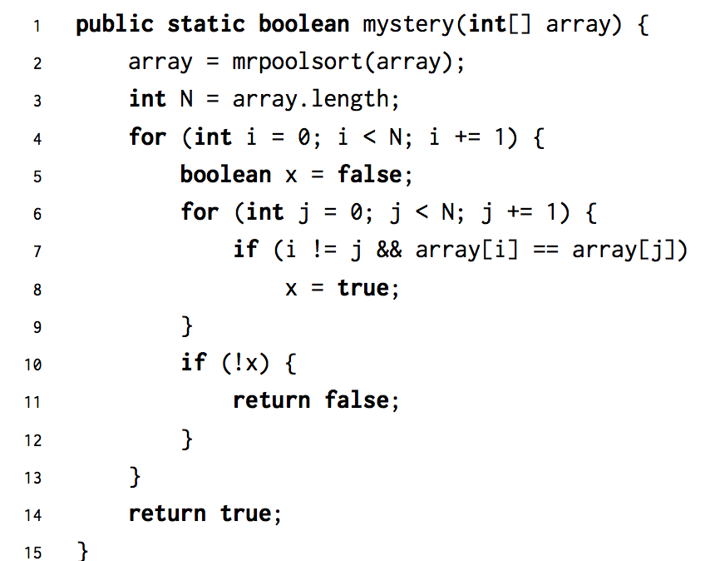
Problem 2b: Analyzing Runtime

Slide 14
Problem 2b: Analyzing Runtime
Worst: N^2
Best: N log N
Returns true if every int has duplicate in array and false if there is any unique int in array
Linear-time algorithm using map

Slide 15
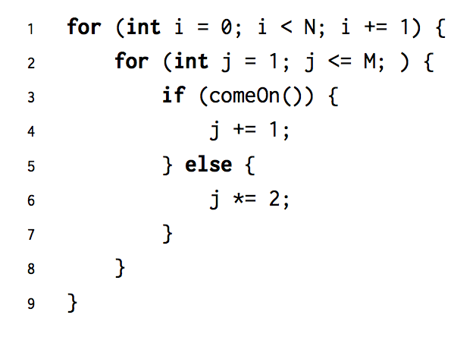
Problem 2c: Analyzing Runtime
Notes:
Teaching Goals: Similar as before.

Slide 16
Problem 2c: Analyzing Runtime
Worst: NM
Best: N log M

Slide 17
Problem 3: Fast
What is the current runtime of the algorithm?
Remember that the array is sorted!
Notes:
Teaching Goals: Take an existing algorithm and improve it by understanding the current runtime and mechanics to make a better algorithm. Understand that asymptotics is a quantitative measure of a more efficient algorithm.

Slide 18
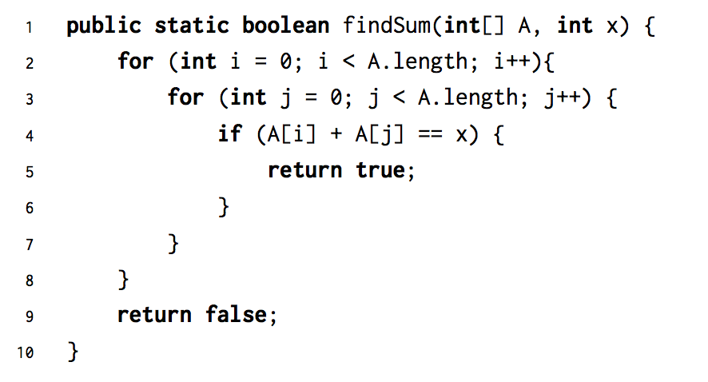
Problem 3: Fast

Slide 19
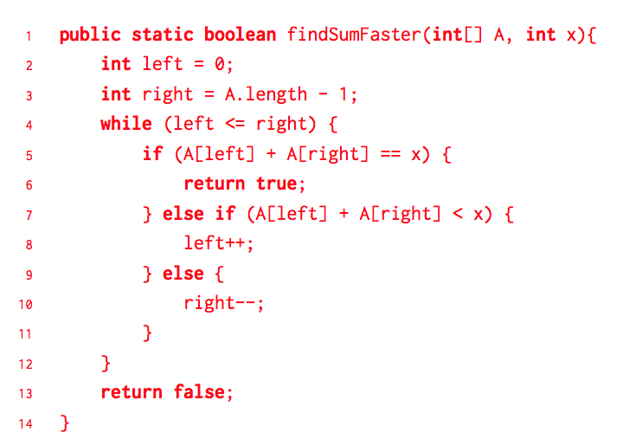
Problem 3: Fast
Naive
Worst: N^2
Best: 1
Optimized
Worst: N
Best: 1

Slide 20
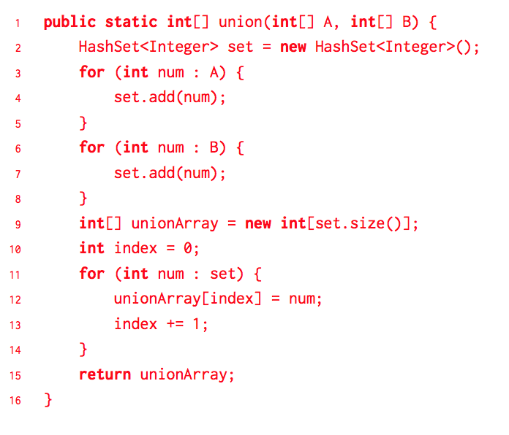
Problem 4: CTCI

Slide 21
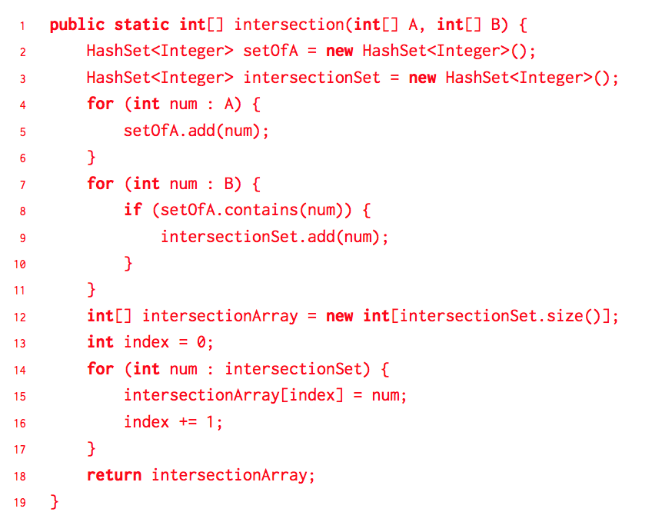
Problem 4: CTCI

